Slide 1
Demo Day Preparation
Dirk Riehle, Univ. Erlangen
AMOS C01
Licensed under CC BY 4.0 International

Slide 2
Agenda
Demo day
Demo day slide
Demo day posters
Demo day video
Final release
Final documentation
Final planning documents
Final release tag
After-work
Project report
Project retrospective

Slide 3
AMOS Course Feedback
Please take the following three questions survey
https://forms.gle/sRyzveeziYB4aX6P8
The next generation of students says thank you!

Slide 4
1. Demo Day

Slide 5
The AMOS Demo Day
The demo day is the final day of the course
The demo day is organized as a fair (“Messe”)
Student teams show the results of their project
Audience are industry partners and fellow students

Slide 6
Demo Day Process
Opening (20 min.)
General introduction
1 slide, 1 min. introduction by each team (one speaker)
Demos (duration depends on number of projects)
After the introduction, we split up into the different projects
One demo room (online) for each project
At least one person from each project needs to be ready to demo
Demo day participants (including students without booth duty) roam around
Closing (5 min.)
We come together in the main room to say goodbye

Slide 7
Typical Demo Day Schedule
Time | Duration | Responsible | Title | Room
10:15 | 10 min | Riehle | Introduction | Main room
10:25 | 10 min | Teams | One slide summary | Main room
10:35 | 20 min | Teams | Demo | Demo rooms
10:55 | 20 min | Teams | Demo | Demo rooms
11:15 | 20 min | Teams | Demo | Demo rooms
11:35 | 20 min | Teams | Demo | Demo rooms
11:55 | 20 min | Teams | Demo | Demo rooms
12:15 | 5 min | Riehle | Conclusions | Main room

Slide 8
One-Time Deliverable: Demo Day Slide
Please create one 16x9 slide to show during the demo day opening

Slide 9
Online Demo Room
We will create Zoom breakout rooms for each project
You will demo your work in your breakout room
Demo your project using your laptop
Support your demo using a slide deck; should contain
One slide on product management
One slide on software development
A team photo slide (can be screenshot)
Have the demo day video ready as a backup

Slide 10
Use of Corporate Identities
Please use your university logo
Please use your team logo
Please use your industry partner logo, but ask first

Slide 11
One-Time Deliverable: Demo Day Posters
Please create two posters for your demo day booth
One product management / product owner poster
One software development poster

Slide 12
Structure of a Demo Day Session (of Several)
At | What happens / to do
0min. | Demo room opens, participants stream in
1min. | Demo starts
10min. | Demo finishes, discussion starts
19min. | 60 second countdown to room closing starts
20min. | Room closes, everyone is pulled back into the main room

Slide 13
Demo Preparation
Dos
Have a clean user interface
Have a story to tell, for example,
A day in the life of …
A workflow example
Use domain terms and examples
In the user interface (labels, titles)
In the stories you tell
Make the demo data reentrant
You will have to start over repeatedly
You want to start at the same point
Don’ts
Use “test1” or “user2” as labels
Not follow the advice on the left

Slide 14
Demo First! Slides… Fifth? Nineteenth?
Demo your software! That’s what it is about
A good approach is to demo a main feature or use case
And only then explain it using slides
And then demo another feature or use case that adds to the previous one
And then explain it using slides
And finally demo a third feature
After which you will open the discussion
Don’t be afraid of open time for questions

Slide 15
One-Time Deliverable: Demo Day Video
Please create a 3 min. video demoing your work
You should show running software, not just talk about it!
The demo video will be your demo backup
Will also be posted on our blog and on LinkedIn

Slide 16
Demo Execution
Have two people ready to demo
One explains what is going on (talks to people)
One demos the software in line with story

Slide 17
2. Final Release

Slide 18
One-Time Deliverable: Final Documentation
Please clean-up and finalize your documentation

Slide 19
One-Time Deliverable: Final Planning Documents
Please clean up your planning documents, in particular the final release plan

Slide 20
One-Time Deliverable: Final Release Tag
Please clean up your code base, in particular set the final-release tag

Slide 21
3. After-work

Slide 22
One-Time Deliverable: Project Report
Please create a project report using our template
The report will be posted on our blog and on LinkedIn (together with your video)

Slide 23
One-Time Deliverable: Project Retrospective
Please perform a project retrospective (guided by your Scrum Master)

Slide 24
Summary
Demo day
Demo day slide
Demo day posters
Demo day video
Final release
Final documentation
Final planning documents
Final release tag
After-work
Project report
Project retrospective

Slide 25
Thank you! Any questions?
dirk.riehle@fau.de – https://oss.cs.fau.de
dirk@riehle.org – https://dirkriehle.com – @dirkriehle

Slide 26
Legal Notices
License
Licensed under the CC BY 4.0 International license
Copyright
© Copyright 2009, 2024 Dirk Riehle, some rights reserved

Slide 27
Archive

Slide 28

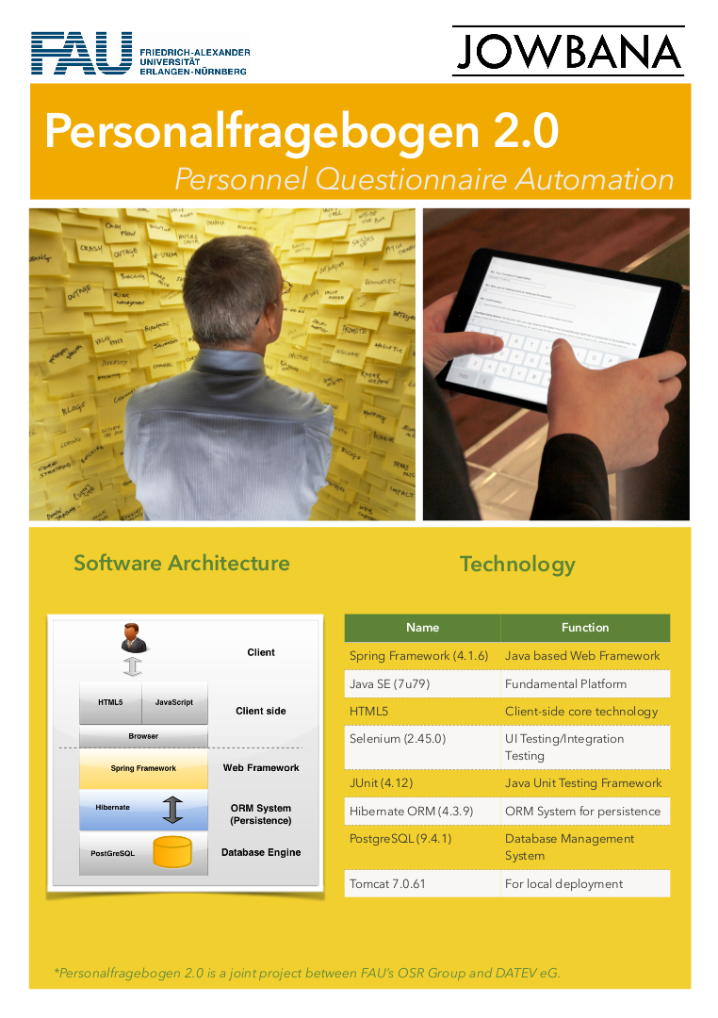
Example Posters 1 / 2

Slide 29
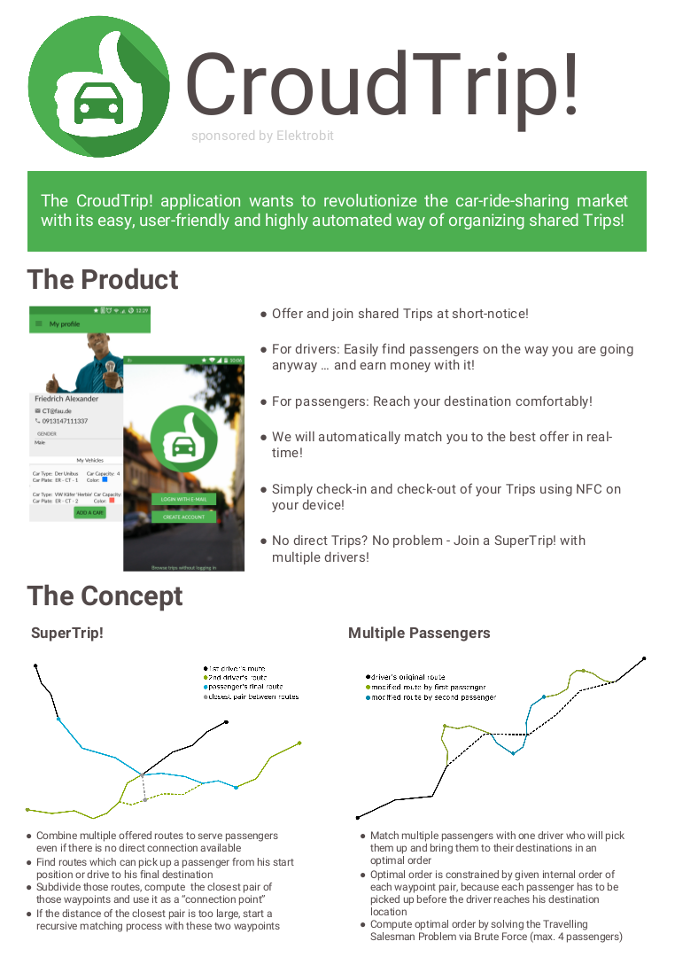
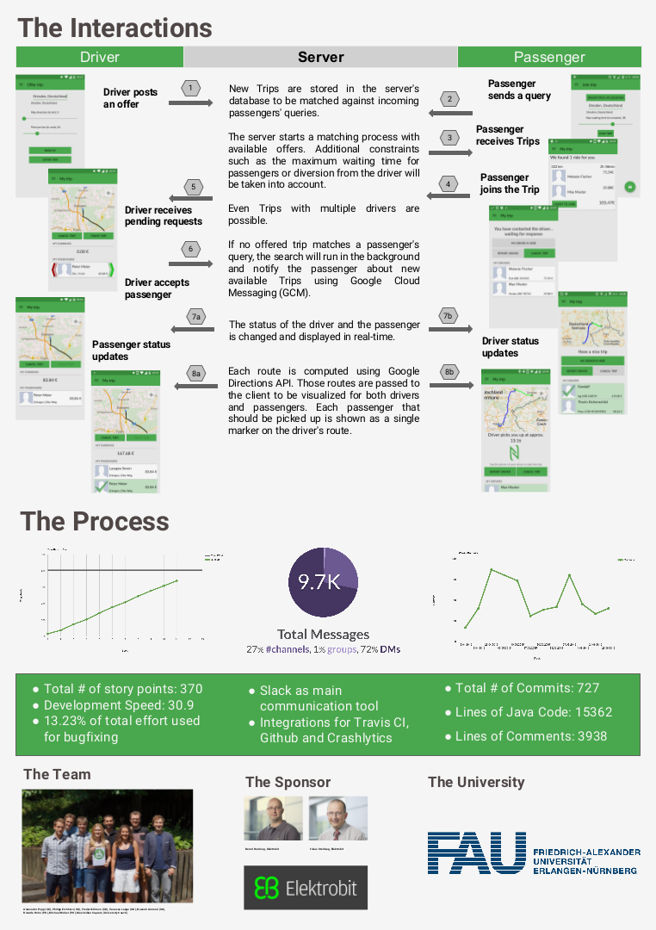
Example Posters 2 / 2

